Slide 1
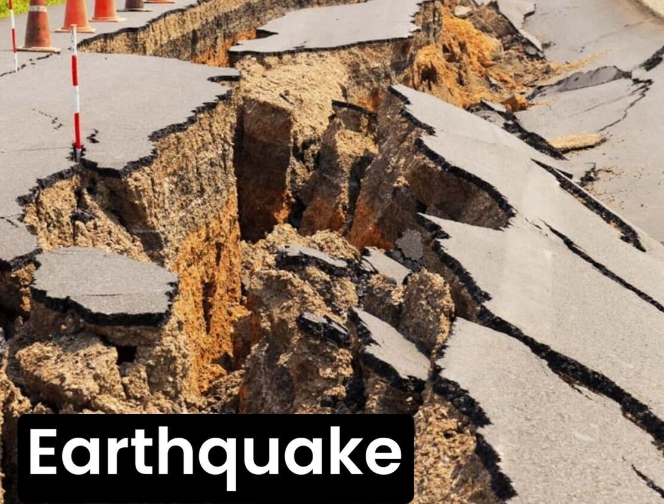
Earthquakes Through The Decades
By Andrew Hunt

Slide 2
Questions That’ll Be Answered
Which decade had the most earthquakes?
Are tectonic plates related to earthquakes?
Which decade had the highest magnitude average?
Which decade had the highest depth average?
Do depth and magnitude have a correlation?

Slide 3
Importing and Reviewing Data
The following data is the result from a csv on all earthquakes from 1900 to present
Since the data spans over 120 years I decided to separate the data into different decades.

Slide 4
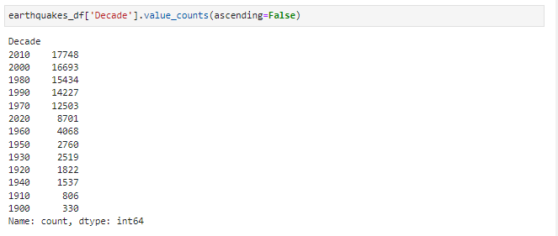
Which decade had the most earthquakes?
The 2010s with 17,748

Slide 5
Side Note
Earthquake count appears to be higher in more recent decades than past decades

Slide 6
Making Map of Earthquakes
Since the dataset had latitude and longitude columns, a geoviews map was able to be made
The table had 23 columns and over half of them were dropped (wasn’t necessary, but it made things easier)
In order to plot the map, the latitude and longitude columns had to be rounded to two decimal places

Slide 7
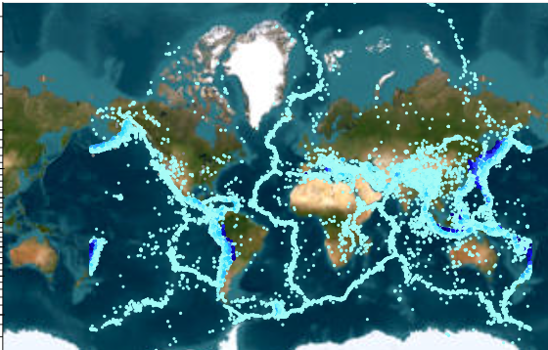
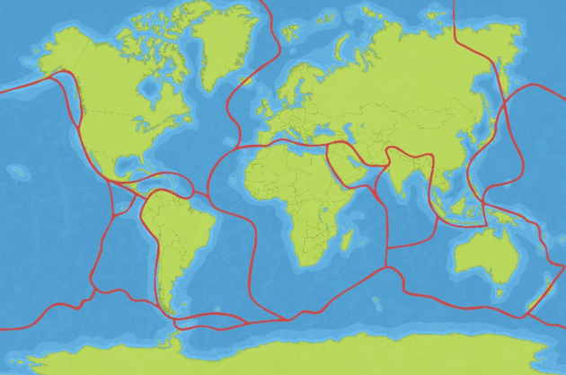
Results
Geoviews Map of Earthquakes
Diagram of tectonic plates

Slide 8
Are tectonic plates related to earthquakes?
Yes. The outline of the tectonic plates matched exactly with the pattern of earthquakes, leading to evidence that earthquakes result in the taring of tectonic plates.

Slide 9
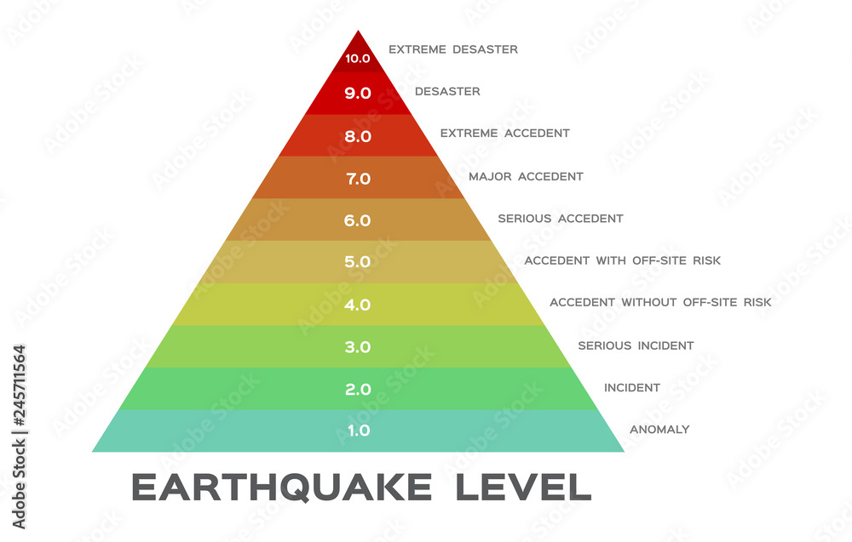
Magnitude

Slide 10

Exploring Magnitude
To make things even simpler, more columns were deleted until there was Number index, Depth, Magnitude, and Decade
By using the groupby function and calculating the mean of magnitude, I was able to make a chart of the average magnitude per decade
With hvplot, was also able to make a line chart for range of magnitudes

Slide 11
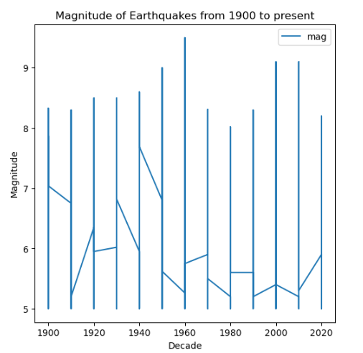
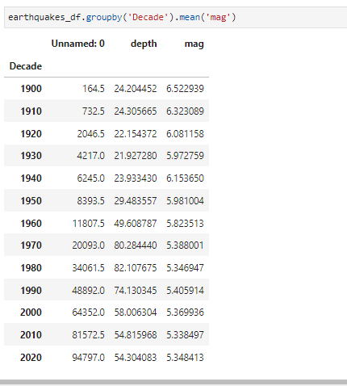
Results
Line Chart of Ranges
Table of Magnitude Averages

Slide 12
Which decade had the highest magnitude average?
The 1900s had the highest magnitude average
However, according to the line chart the 1960s had the biggest range of magnitudes

Slide 13
Calculating Depth
Since the data was already grouped by decade, figuring out depth was the same procedure as figuring out magnitude
A line plot was made to show the different depth values and a groupby was used to calculate average depth per decade

Slide 14
Which decade had the highest depth average?
The 1980s had the highest average.
From the 1970s and after, the average depth is higher than 50, whereas in the 1960s and before the average is less than 50.
This leads us to the theory that ripping of tectonic plates over time could be resulting in the average depth increasing over time.

Slide 15
Final Step
The final step was to figure out the correlation between magnitude and depth
In order to do that, magnitude values were put in x-axis and depth values were put in y-axis

Slide 16
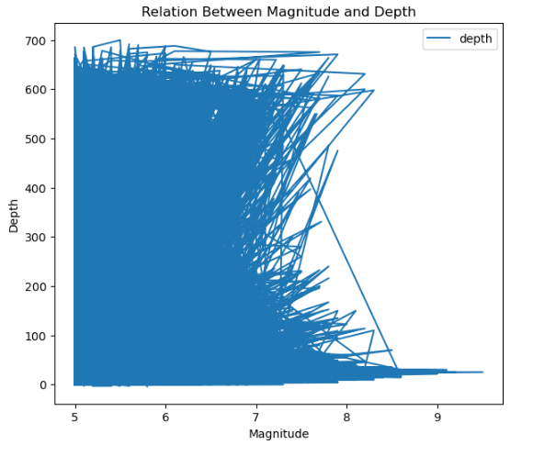
Results

Slide 17
Do depth and magnitude have a correlation?
No. The line chart moves in several directions. From left to right, right to left, up to down, and down to up. Because of that there is no distinguishable correlation.

Slide 18
In conclusion…
Earthquakes are more common in present then they were in past
Earthquakes are a result of tectonic plates taring
Average depth of earthquakes tends to get higher over time
There is no correlation between magnitude and depth
You do not want to be in the middle of an earthquake

